Slide 1

EDP CAPSTONE
BANKING INDUSTRY
“Loan Risk”
Group Members:
Mazamirrul Drahman
Hemavathy A/P Palaniappan
Mohalila Jubli

Slide 2

PROBLEM STATEMENT
TOP THREE (3) FACTORS WHY THE LOAN BEING APPROVED AND REJECTED?
Education
Gender
Loan default
HOW TO SUCCESSFULLY GET YOUR LOAN APPROVED?
To get education

Slide 3
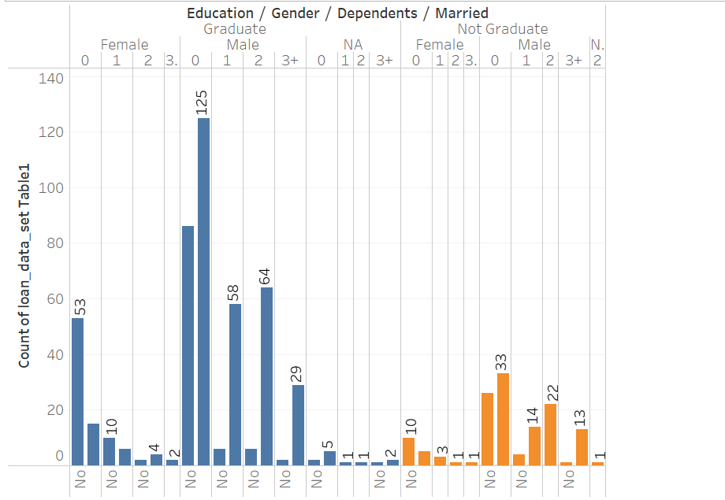

Slide 4
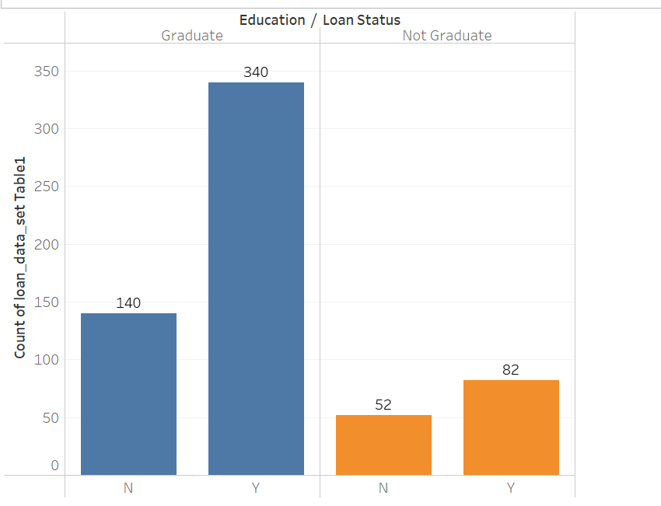
Education vs Loan Status

Slide 5
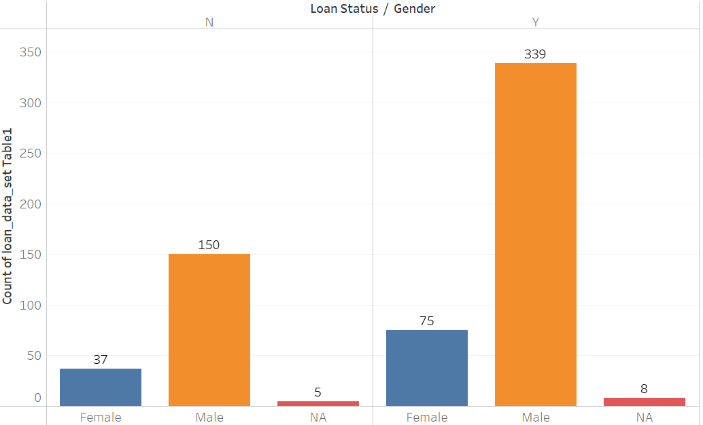
Gender vs Loan Status

Slide 6
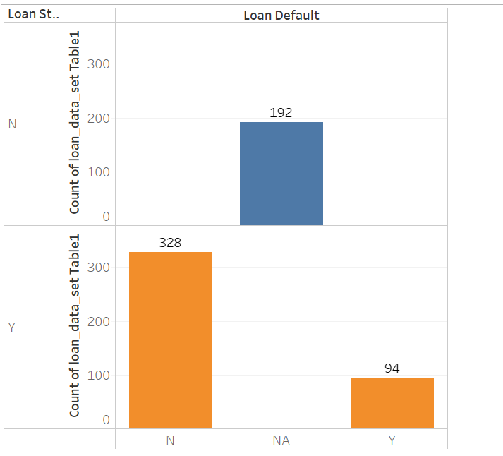
Loan Default vs Loan Status

